Slide 1
Qt GUI Development

Slide 2
A little bit about myself
Application Engineer at ThinkRF
Developed APIs/GUIs in C/C++, Octave, Matlab, Labview, Python, Visual Basic
Email: mfarhan102@gmail.com
Github: github.com/mfarhan12
Interests: signal processing (biological/wireless)

Slide 3
What is Qt
GUI Application Framework developed in C++
Originally developed by Nokia, eventually evolved into a open source project
Supported in Python with PySide and PyQt
PyQt uses GPL license, PySIde uses LGPL license

Slide 4
How to get the most out of this
Try the examples
https://github.com/mfarhan12/qt-presentation.git
Use the documentation/Stackoverflow
More than one way of doing something
Useful for small scripts as well as large applications

Slide 5
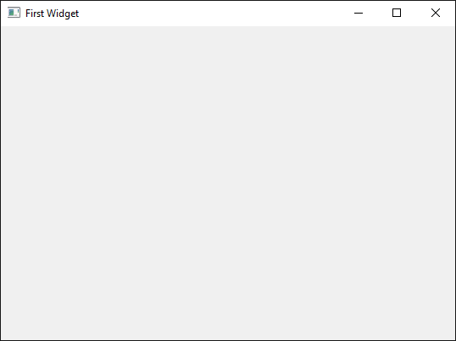
Simple Widget
from PySide import QtGui, QtCore
import sys
class SimpleWidget(QtGui.QWidget):
  def __init__(self):
super(SimpleWidget, self).__init__()
  self.show()
# Launch the application
app = QtGui.QApplication(sys.argv)
ex = SimpleWidget()
sys.exit(app.exec_())
simple_widget.py

Slide 6
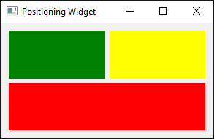
Widget Positioning
def __init__(self):
...
  grid = QtGui.QGridLayout()
  green_label = QtGui.QLabel('')
  yellow_label = QtGui.QLabel('')
  red_label = QtGui.QLabel('')
  grid.addWidget(green_label, 0,0,1,1)
  grid.addWidget(yellow_label, 0,1,1,1)
  grid.addWidget(red_label, 1,0,1,2)
  self.setLayout(grid)
widget_positioning.py

Slide 7
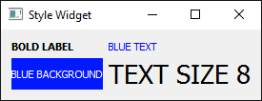
Widget Styling
QT can use CSS to style widgetsWidget
bold_text.setStyleSheet('font-weight: bold')
blue_text.setStyleSheet('color: blue')
size_label.setStyleSheet('font-size:20pt')
blue_background.setStyleSheet('background-color: rgb(0,25,255); color: white')
widget_styles.py

Slide 8
Widget Controls
Enables User to change parameters
Hundreds of Widget controls (button, textbox, combobox, checkbox, etc)
More than one way of doing something
Controls usually emit signals

Slide 9
Widget Signals and Slots
Signals are emitted whenever an event occurs in Qt
Example: button clicked, text is changed, combo box item changed, etc
Slots are called whenever those signals are emitted.

Slide 10
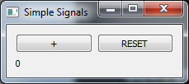
def __init__(self):
...
  self.result_label = QtGui.QLabel('%d' % self._count)
  self.button = QtGui.QPushButton('+')
  self.reset = QtGui.QPushButton('RESET')
  def add_count():
    self._count += 1
    self.result_label.setText('%d' % self._count)
  self.button.clicked.connect(add_count)
  def reset_count():
    self._count = 0
    self.result_label.setText('%d' % self._count)
  self.reset.clicked.connect(reset_count)
Widget Signals and Slots
simple_signal.py

Slide 11
Calculator
Add, Subtract, Multiply or divide two floats
Everytime an operation, or a number is changed, the result value is recalculated and displayed
Handle division by zero

Slide 12
Calculator: Initializing Controls
Two spinboxes for inputs
self.spin1 = QtGui.QDoubleSpinBox()
self.spin2 = QtGui.QDoubleSpinBox()
Radio buttons for operation
self.add = QtGui.QRadioButton('+')
self.sub = QtGui.QRadioButton('-')
self.mul = QtGui.QRadioButton('X')
self.div = QtGui.QRadioButton('/')
Label Display Result
self.result_label = QtGui.QLabel('')
simple_calculator.py

Slide 13
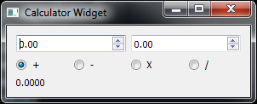
Calculator: Positioning
grid.addWidget(self.spin1, 0,0,1,2)
grid.addWidget(self.spin2, 0,2,1,2)
grid.addWidget(self.add, 1,0,1,1)
grid.addWidget(self.sub, 1,1,1,1)
grid.addWidget(self.mul, 1,2,1,1)
grid.addWidget(self.div, 1,3,1,1)
grid.addWidget(self.result_label, 2,0,1,2)
simple_calculator.py

Slide 14
Calculator: Connecting Signals
def update_num():
self._num1 = self.spin1.value()
self._num2 = self.spin2.value()
self._calculate_result()
self.spin1.valueChanged.connect(update_num)
self.spin2.valueChanged.connect(update_num)
def update_operation(widget):
self._operation = widget.text()
self._calculate_result()
self.add.clicked.connect(lambda: update_operation(self.add))
self.sub.clicked.connect(lambda: update_operation(self.sub))
self.div.clicked.connect(lambda: update_operation(self.div))
self.mul.clicked.connect(lambda: update_operation(self.mul))
simple_calculator.py

Slide 15
Calculator: The calculator Part
def _calculate_result(self):
try:
if self._operation == '+':
result = self._num1 + self._num2
if self._operation == '-':
result = self._num1 - self._num2
if self._operation == 'X':
result = self._num1 * self._num2
if self._operation == '/':
result = self._num1 / self._num2
self.result_label.setText('%0.4f' % (result))
except ZeroDivisionError:
self.result_label.setText('INF')
simple_calculator.py

Slide 16
Custom Widgets/Signals
Custom widgets use the standard widget as a base (parent),
Custom signals can be used to emit a signal inside a custom widget. Custom signals can be emitted by custom actions/events/cases with custom parameters

Slide 17
Custom Calculator
Remove label, add signal
class Calculator(QtGui.QWidget):
new_calculation = QtCore.Signal(float, float, str, str)
def _calculate_result(self):
....
self.new_calculation.emit(self._num1,
self._num2,
self._operation,
'%0.4f' % result)
custom_widget.py

Slide 18
Calling Custom Calculator
class CalculatorWidget(QtGui.QWidget):
def __init__(self):
...
self.calculator = Calculator()
self.list = QtGui.QListWidget()
def got_result(num1,num2, operation, result):
txt = ('%0.4f %s %0.4f = %s' % (num1, operation, num2, result))
self.list.addItem(txt)
self.calculator.new_calculation.connect(got_result)
custom_widget.py

Slide 19
PyQtGraph
Developed using Qt, so can be integrated into any Widget
Easy to use
Fast
Tons of capability

Slide 20
PyQtGraph Examples
Running the following launches the examples:
import pyqtgraph.examples
pyqtgraph.examples.run()
pyqtgraph_examples.py

Slide 21
Simple Plot
def __init__(self):
# initialize stuff
line_plot = pg.PlotWidget(title="Simple Plot")
self.curve = line_plot.plot(pen = "r")
line_plot .showGrid(x=True, y=True)
line_plot .setLabel('left', "Voltage", units='V')
line_plot .setLabel('bottom', "Time", units='T')
x = np.linspace(0, 1, 1024)
wave = 5 * np.sin(2 * np.pi * 5 * x)
self.curve = line_plot.plot(pen = "r")
self.curve.setData(x, wave)
simple_plot.py

Slide 22
Plot Regions
full_plot = pg.PlotWidget(title="Region Selection")
region_selector = pg.LinearRegionItem([400,700])
full_plot.addItem(region_selector)
region_plot = pg.PlotWidget(title="Zoom on selected region")
def updatePlot():
region_plot.setXRange(*region_selector.getRegion())
def updateRegion():
region_selector.setRegion(region_plot.getViewBox().viewRange()[0])
region_selector.sigRegionChanged.connect(updatePlot)
region_plot.sigXRangeChanged.connect(updateRegion)
simple_region.py

Slide 23
Continuously Plot
def __init__(self):
...
self.timer = QtCore.QTimer()
self.timer.timeout.connect(self._update_plot)
self.timer.start(50)
def _update_plot(self):
data = 5 * np.sin(2 * np.pi * freq * x)
self.curve.setData(wave)
updating_plot.py

Slide 24
3D Plots
For small scripts, use a single class
For large applications, try to seperate different portions into seperate classes

Slide 25
Architecture
For small scripts, use a single class
For large applications, try to seperate different portions into seperate classes

Slide 26
Questions?

